Slide 1
“C” programming

Slide 2
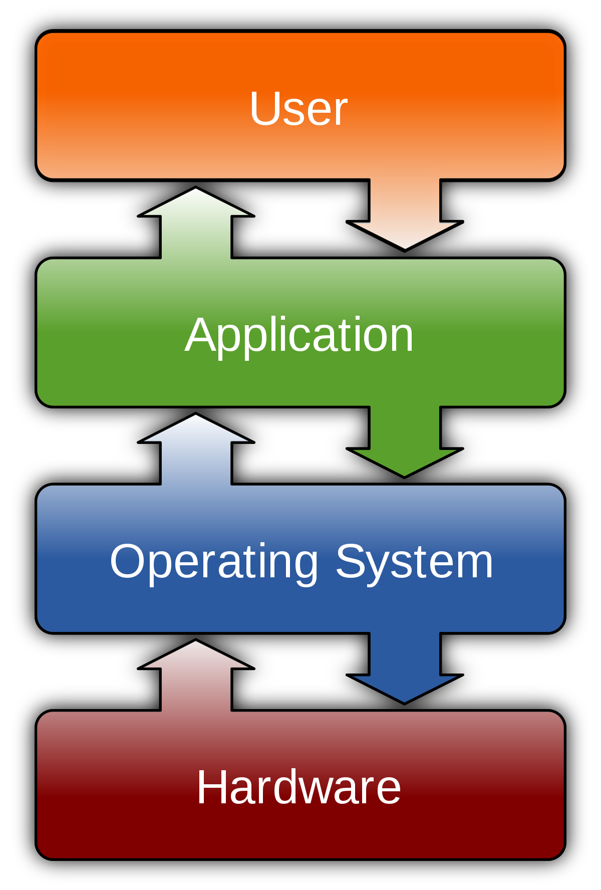
Stack of a
General Purpose Computer

Slide 3
Types Of
Programming Languages
Machine language
Assembly language
High level languages

Slide 4
Some Terminologies
Related To Software
Compiler
Interpreter
IDE (Integrated Development Environment)
    Editor
    Compiler
    Linker
    Debugger
    simulator

Slide 5
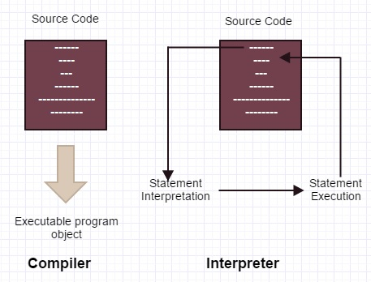
Compiler versus Interpreter

Slide 6
History and usage
1970
Denis Ritchie and Ken Thompson (Bell labs)
low-level : hardware access, faster than any other language except Assembly language
Usage:
    System programming (including the OS kernel)
    Compilers and interpreters for other languages
    Virtual machines
    Embedded systems, robots
    Network protocols (TCP/IP)
    Signal and image processing libraries
Gilles Carpentier ISEP
6

Slide 7
Comments
comments are ignored by the compiler
Multiline comment : Everything between /* and */
  Can not be nested
  Single line comment (introduced with C++) : Everything after // on the same line

Slide 8
Variable versus Constants
Variable :
  The block of memory allocated according to the type.
  Should be declared before its usage.
  Can be modified as & when needed in the program
  e.g - int a;
  char c;
Constant :
  Can be directly used in the program without any declaration
  e.g - area = 3.14 * r * r;
  c = ‘A’;
  i = j +10;
Gilles Carpentier ISEP
8

Slide 9
Syntax
Indentation, spacing and line feeds are not mandatory
  Identifier (name of the variable or function) : sequence of letters (lowercase and uppercase), digits and underscore (_)
  *** Avoid to begin with an underscore (identifiers used by the system)

Slide 10
Rules for identifier in “C”
First letter must be an alphabet or underscore
Must consist of only alphabets(lower or upper), digits & underscore
  Must not contain special characters ( ? , ; : )
  Must not be a keyword (int,char,if,for…)
Must not contain whitespace(space,enter,tab)
Some legal identifiers
a
abc_xyz
pqr12
normal_room_temp
Some illegal identifiers
1a
abc?xyz
if
normal room temp

Slide 11
Data Types in “C”
Data type | Format specifier
int | %d (signed) , %u (unsigned)
Char (ASCII codes) | %c ( signed & unsigned both )
Float (~10³⁸) | %f
Double (~10³⁰⁸) | %lf
long | %ld (signed) , %lu (unsigned)
short | %hi (signed), %hu (unsigned)
Long double (~10⁴⁹³² ) (10 bytes) | %Lf
Void | -

Slide 12


